Slide 1


Rogue Chess Team 15: Travis Head, Jose Herrera

Slide 2
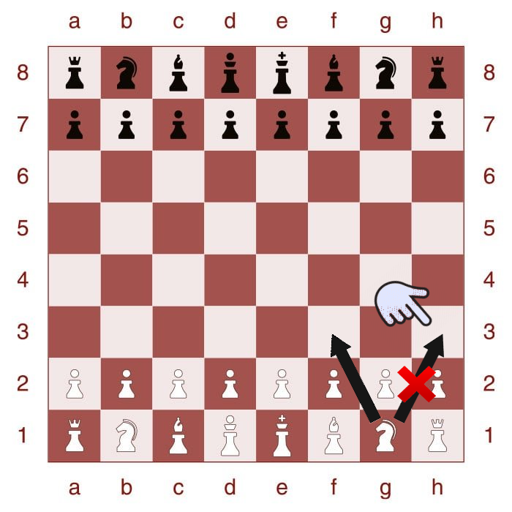
Project description
Problem statement: “The game of chess has existed for centuries. While there are beginners and masters, many are looking for new challenging ways to play the game.
Develop an app of a new chess variation for Android product.
Pieces will ignore the instructions of the user at random intervals.
This will challenge the user’s typical strategies in chess and provide a unique experience that is unavailable elsewhere online or in person.

Slide 3
Project description
Solution proposal: “Develop an application with a randomization function based on the difficulty the user chooses”
Randomization based on probability.
Android Studio (App Developer)
Java
Multi-threading
allows for multiple threads to be created within a process
executing independently but concurrently sharing process resources
Single Player vs AI
Player vs Player
Modes | Easy | Medium | Hard
Probability of piece will listen | 90% | 70% | 50%

Slide 4
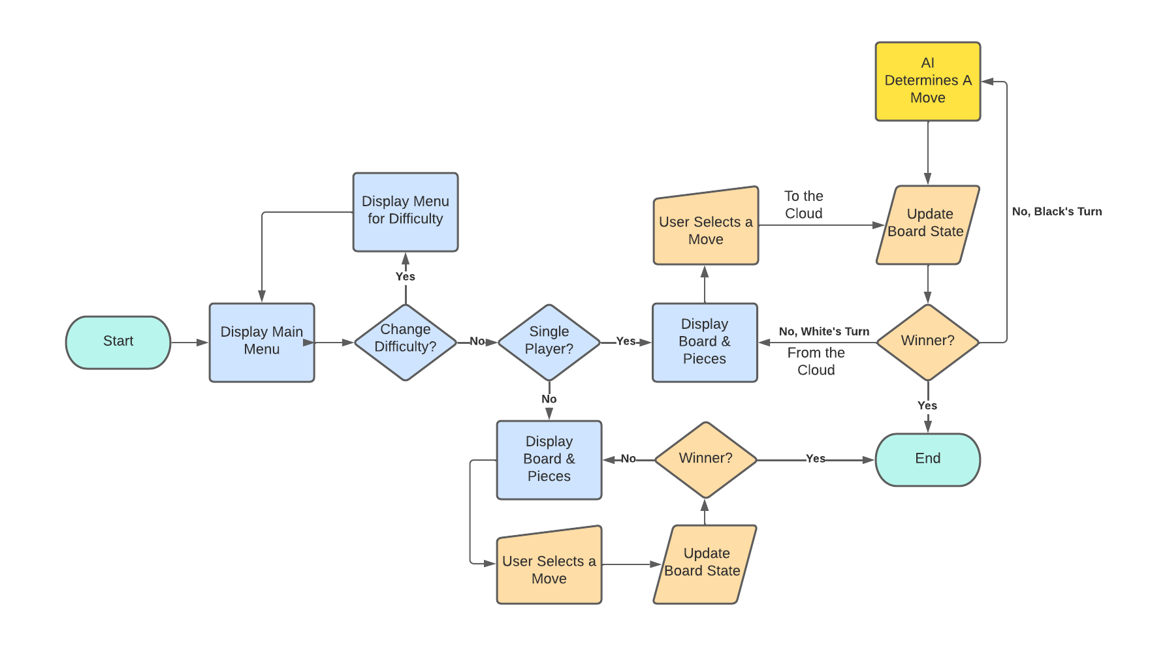
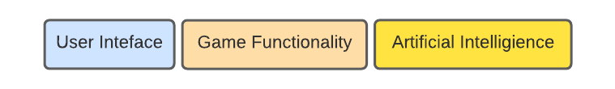
Diagram of subsystems and interface

Slide 5
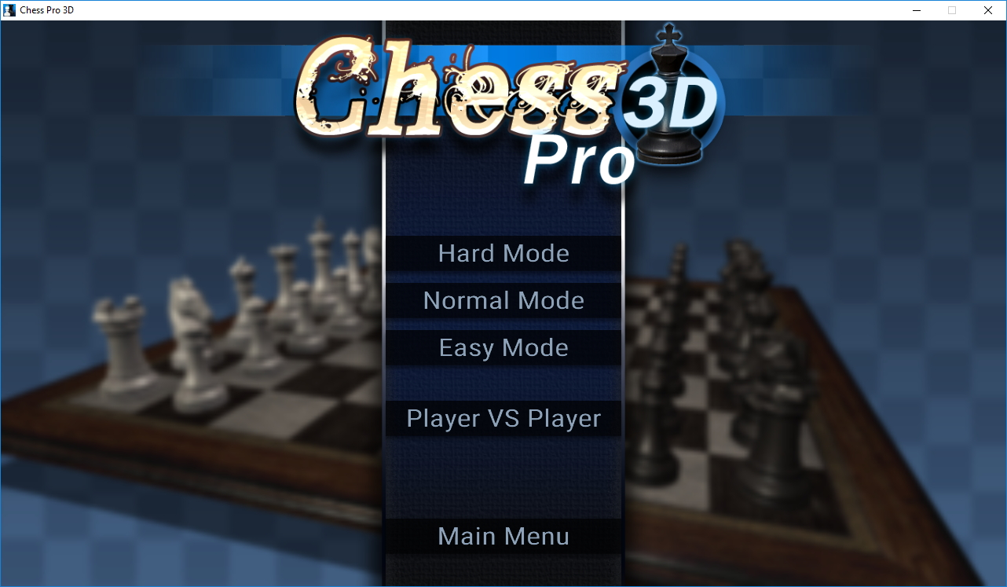
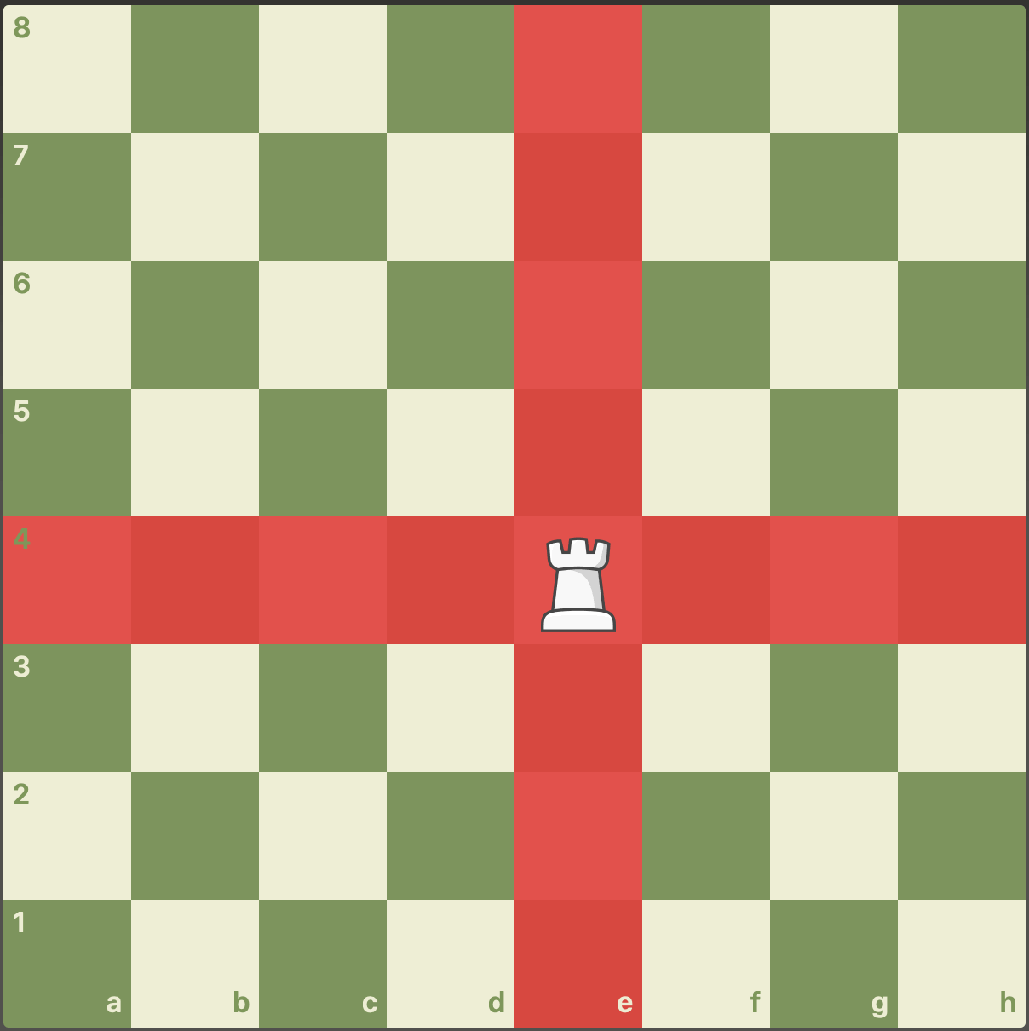
Subsystem 1: User Interface
Graphics
Pieces
Board
Main Menu
Difficulty Modes (sub menu)
Single Player
Player vs Player
The highlighted squares are visible

Slide 6
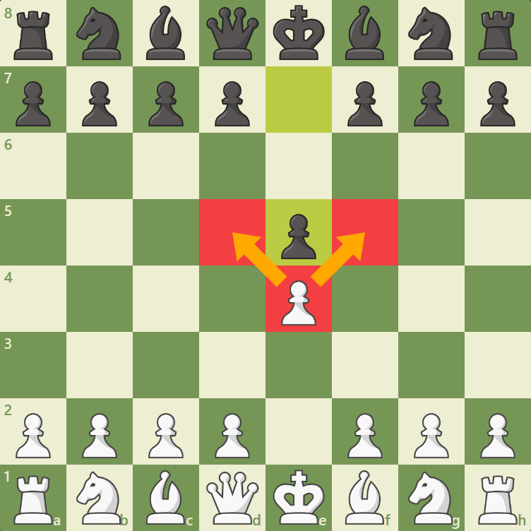
Subsystem 2: Game Functionality
Android Studio (App Developer)
Highlighted Squares
Highlight legal moves
Randomizer
If random choose a different spot
Tap and Move
User taps a tile and the piece moves
Legality of the Moves
If user tries to make an illegal move the game will not do anything until a legal move is made

Slide 7
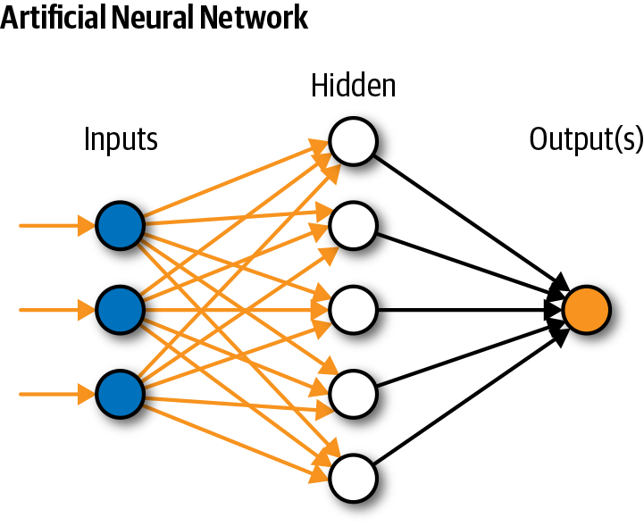
Subsystem 3: Artificial Intelligence
Neural Network using Python & TensorFlow
Python best machine learning language
Stored in Microsoft Azure
Azure good for game and app development
Decides a move in under 2 seconds
Elo Rating of at least 1300

Slide 8
Task partition
Jose Herrera:
User Interface
Game Functionality
Travis Head:
Artificial Intelligence

Slide 9
Execution plan
 | 2/14 | 2/21 | 2/28 | 3/7 | 3/14 | 3/21 | 3/28 | 4/4 | 4/11 | 4/18 | 4/25 | Date
System Update 1 |  |  |  |  |  |  |  |  |  |  |  | 2/15/22
Research |  |  |  |  |  |  |  |  | Completed |  |  | 2/22/22
Game Menu Appears |  |  |  |  |  |  |  |  | Behind Schedule |  |  | 2/23/22
Midterm Presentation |  |  |  |  |  |  |  |  | Not Started
Implement a Chess Board |  |  |  |  |  |  |  |  | In Progress
Functional AI
Functionality of Menus
System Update 2
Chess Piece Movement
AI Training
AI Rating
Final Design Presentation
Final System Demo
Final Report

Slide 10
Validation plan
Paragraph # | Test Name | Success Criteria | Methodology | Status | Responsible Engineer
8.2.2.1 | Data Size Requirements | Application is under 20Mb. | View file size and validate. | Untested | Jose
8.2.3.1 | Randomization Difficulty | 90%, 70%, or 50% obedience rate corresponding to Easy, Medium, Hard. | Record obedience successes on 100 moves from each setting. | Untested | Jose
8.2.3.2 | Chess Piece Movement | Each type of Piece moves only to respective ruleset. | Place each piece in the center/edge of an empty board and input a move to expected and unexpected valid tiles. | Untested | Jose
8.2.3.4 | App Menu Functionality | Main Menu is visible, and each option is selectable. Selecting a game mode starts a match. Difficulty option opens a new menu that saves selected setting. | Open the application and validate main menu is visible. Select each option on the menu. | Untested | Jose
8.2.1.5 | App Graphics | Menus, board, pieces, and highlighted tiles are all visible when needed. | Open the application and validate visibility. Start a match in each mode and select/deselect pieces. | Untested | Jose
8.2.1.6 | Artificial Intelligence Rating | Elo Rating of at least 1300. | Run the AI against another chess program for 10 matches at ratings of 900, 1100, 1200, 1300, 1400, and 1500. | Untested | Travis
8.2.1.7 | Artificial Intelligence Movement | Artificial Intelligence can input a valid move on its turn. | Input a board state and run the AI with a written output. | Untested | Travis

Slide 11
Part order status
Part Description | Status
Samsung Galaxy S7 | Order Placed
Microsoft Azure | Order Received
Android Studio | Order Received

